Slide 1

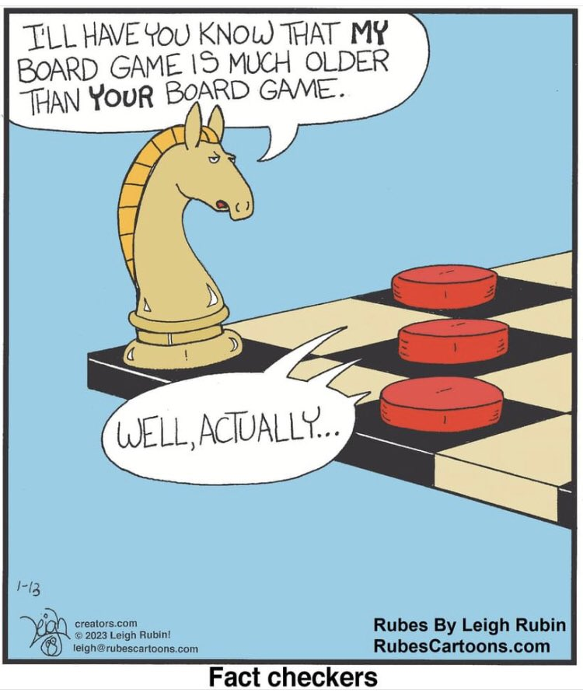
Computational Checkers
By: shiven sasipalli and Shrey mehta
CLPS 0950 FInal project 2023

Slide 2
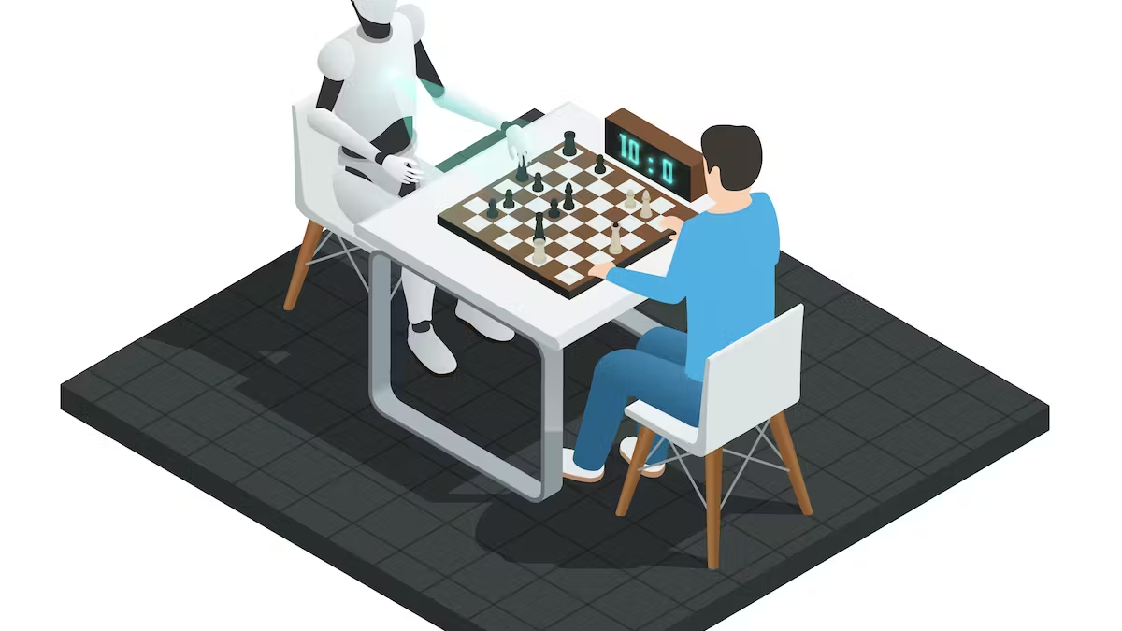
PURPOSE & OBJECTIVE
In hopes of allowing checkers enthusiasts with more opportunities to practice, our program lets a player practice against a CPU!
Note-worthy Functionalities
Creating a "gameboard" in the form of integers in an 8x8 matrix
Allowing players to input moves, check validity with conventional rules, and updating the gameboard accordingly
Using a probability-based model that produce appropriate moves against the player

Slide 3
ASSUMPTIONS
The Player knows how to play checkers and is aware of all rules and regulations.
The code does have a move checker build in, but it only enforces the most basic rules of moving and does not account for any more complicated moves.
The Player understand chess notation, since they will have to input piece movements using a modified chess notation.
Ex: (1,1) -> (2,2) in official chess/checkers notation.
Our code is limited by matrixes/arrays and strings! Thus, inputting the moves with the proper notation is absolutely necessary!

Slide 4
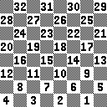
CHECKERS RULES & NOTATION
Pieces can only move diagonally.
To capture a piece of the opponent, your piece leaps over one of the opponent's pieces and lands in a straight diagonal line on the other side, and the landing square must be empty.
If you can capture, you must capture.
If you make it to the end of the board, you become a king, which can then move forwards and backwards diagonally.
To win, you opponent must not be able to make a move.
For notation, treat each square as a point in the cartesian plane with the column being x-coordinate and row being y-coordinate, and separate each number by a space.

Slide 5
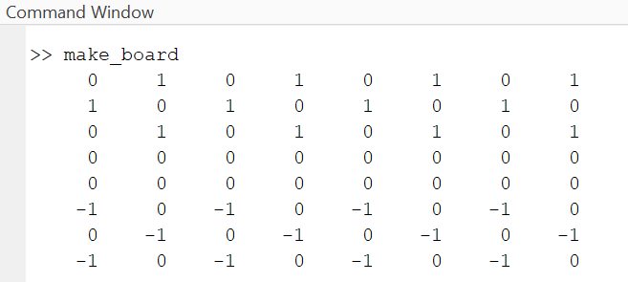
OUR REPLICATION OF THE GAME
The foundational rules of the game are followed in our program too!
System of 1, 0, and -1
1 denotes white pieces, 0 is an unoccupied square, -1 is a black piece
Not all 0s can be moved on, and an algorithm in the code checks whether the move can be made or not

Slide 6
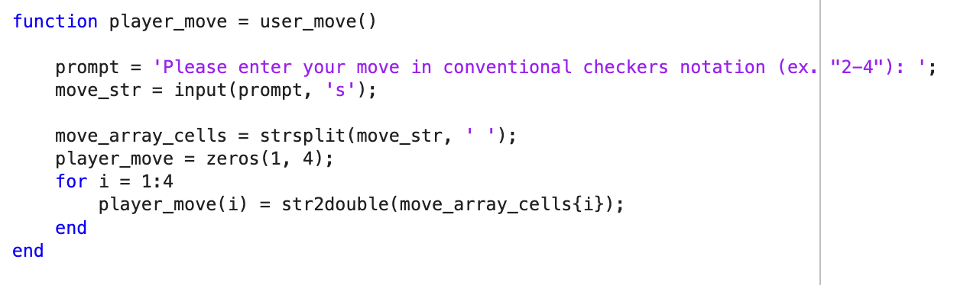
CODE FUNCTIONALITY #1: What is the Move?
Prompts user to input move in proper format
Breaks String apart to be read by code

Slide 7
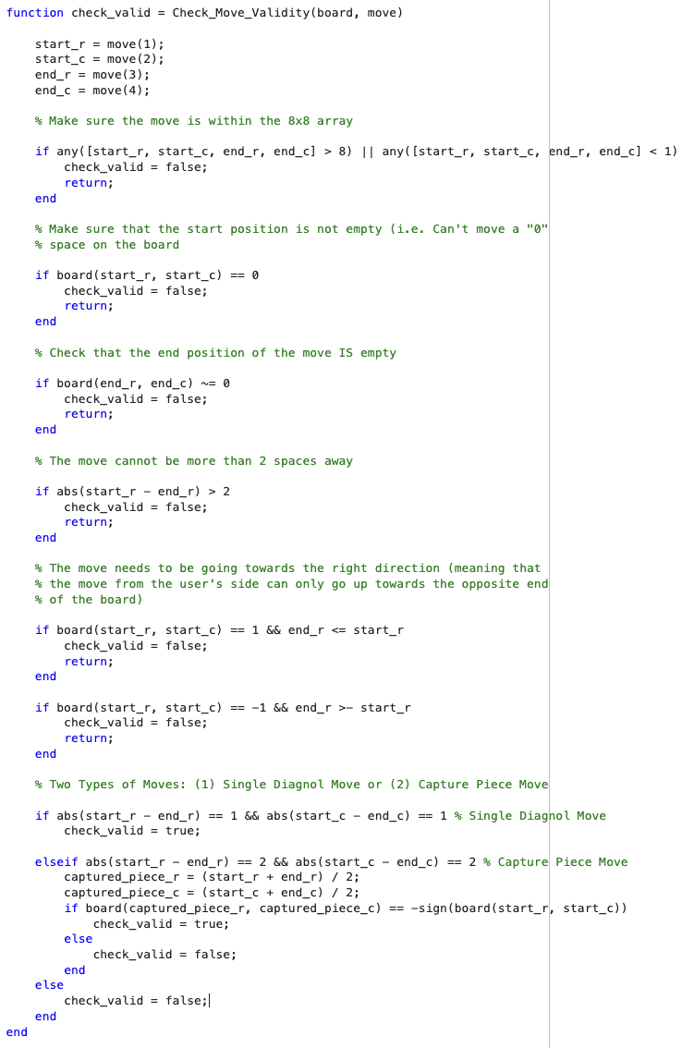
CODE FUNCTIONALITY #2: Is a Move Valid or Not?
Checks if a move follows the rules and regulations, as seen with all of the comments

Slide 8
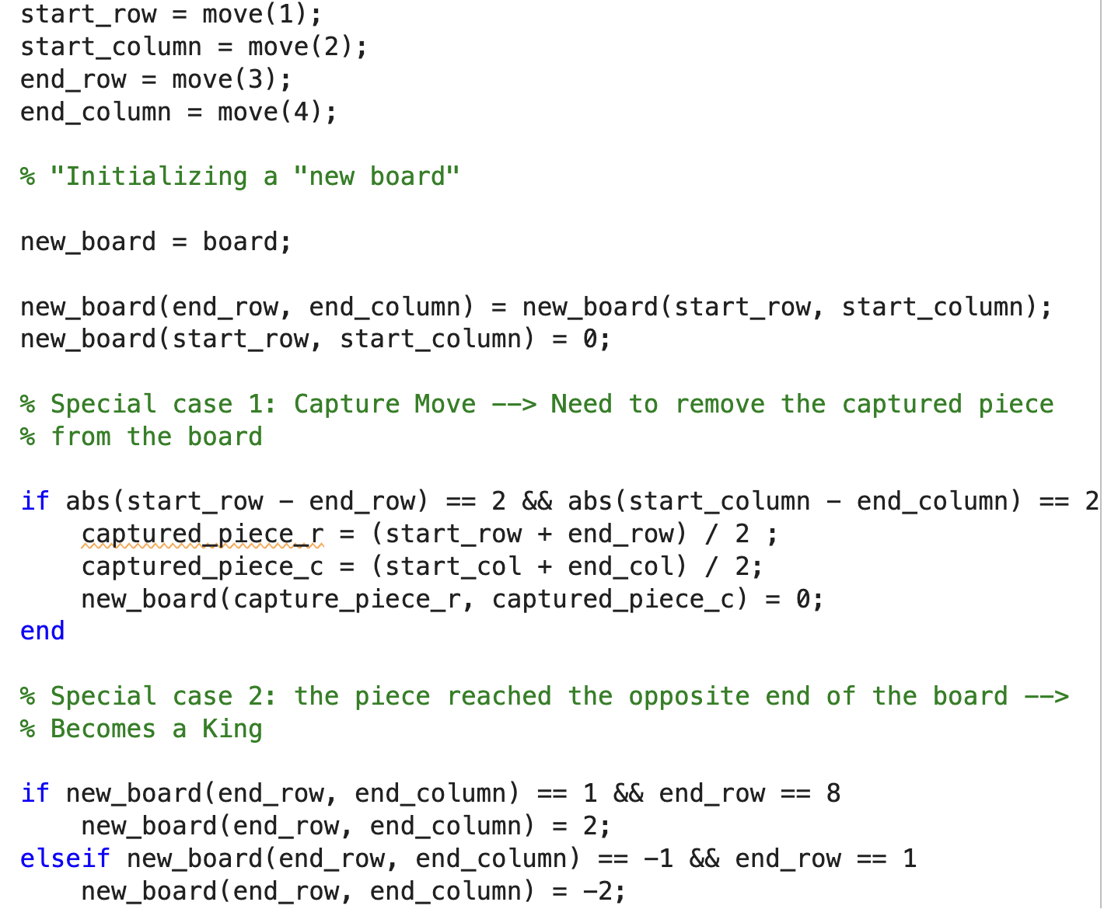
CODE FUNCTIONALITY #3: How do you show the Move?
Splits input in 4 pieces
Uses the pieces to then determine end place of the piece

Slide 9
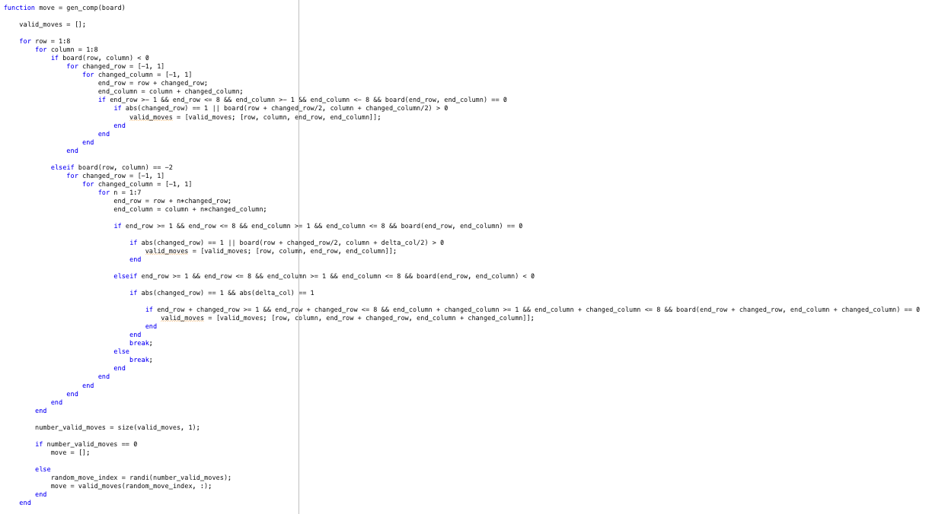
CODE FUNCTIONALITY #4: How does the Computer Respond?
Generates a series of random moves
Checks which are legal, and then randomly chooses from them

Slide 10
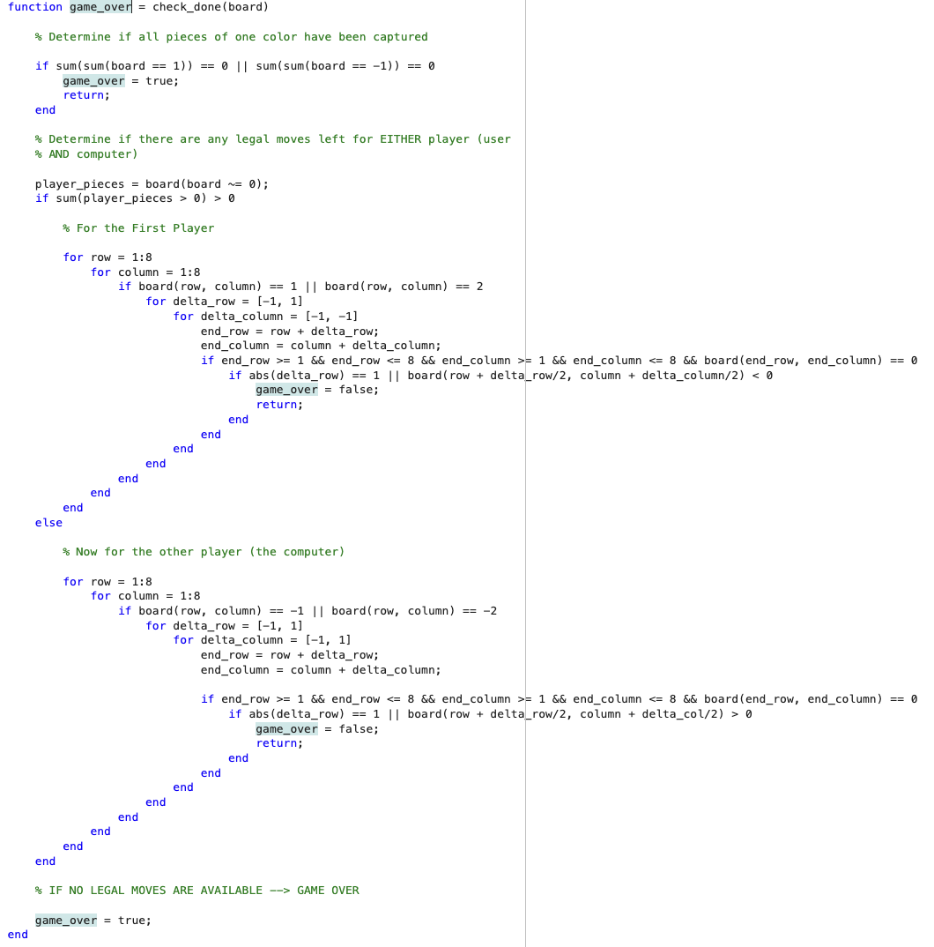
CODE FUNCTIONALITY #5: Is the Game Over?
Checks if there are moves able to be made

Slide 11
PROBABILITY MODEL – RANDOM MOVES
Decided to not implement a full AI because of time and challenges on learning how to implement
Tried to implement a model that uses probability and points to decide how to play against the player
Each forward move gives 1 point, and each piece you capture gets another point, so the model would decide on best move by choosing the one with the highest score

Slide 12
SKILLS WE LEARNED
Matrix Manipulation
How to use matrix and array techniques to create a gameboard
Logical Thinking
Keeping track of different rules in a game
Making sure all those rules are considering through each step of the game/program

Slide 13
CHALLENGES WE FACED
GitHub server issues
Pushing and pulling edits were not happening in the correct directory
"Error 500" -- Seemed like the overall server was down a few mornings
The probabilistic model we tried to implement did not effectively work
Had a lot of difficulty trying to make a board with physical pieces
As a result, had to resort to using an 8x8 matrix as the gameboard

Slide 14
FUTURE IMPROVEMENTS (due to time constraints and skill insufficiencies)
Keyboard and Mouse Implementation
Difficulty levels for the CPU opponent (Easy, Medium Hard)
Visual Graphics with an actual board and pieces (this would go very well with the keyboard and mouse)
2v2 Player functionality in addition to CPU opponent

